Slide 1
Connecting the Pieces for Functional Needs
Before, During and After an Emergency Situation
Developed by Stephanie Brady, The Independent Living Center, Joplin, Missouri
sbrady@ilcenter.org www.ilcenter.org

Slide 2
What is Whole Community?
According to FEMA: “an approach to emergency management that reinforces the fact that FEMA is only one part of our nation’s emergency management team; that we must leverage all of the resources of our collective team in preparing for, protecting against, responding to, recovering from and mitigating against all hazards; and that collectively we must meet the needs of the entire community in each of these areas.”
Essentially, the whole community is planning for and with EVERYONE, regardless of access or functional need and with EVERYONE at the table-- all agencies, community organizations, and consumers working together

Slide 3
St. Mary’s Catholic Church and Elementary School and Green Brier Nursing Home

Slide 4
Who are people with access and functional needs?
Typically anyone who may have difficulty accessing emergency services in a disaster, including:
People with physical disabilities
People with mental health disabilities
People with developmental or cognitive disabilities
People with sensory impairments (vision, hearing)
People with chronic health problems
Senior citizens
Children
People with limited English Proficiency
Geographically or culturally isolated

Slide 5
Why can’t we have separate shelters and services?
On June 22, 1999 in the landmark case Olmstead v. L.C and E.W the U.S. Supreme Court affirmed the right of individuals with access and functional needs to live in their own communities instead of being forced to live in institutional settings.
The 'integration mandate' of the Americans with Disabilities Act requires public agencies to provide services, "In the most integrated setting appropriate to the needs of qualified individuals with disabilities.”
People with access and functional needs are now much less isolated and are largely integrated into our communities. This has important implications for emergency managers, transit providers and for people with access and functional needs themselves, as communities address emergency preparedness and evacuation planning issues.

Slide 6
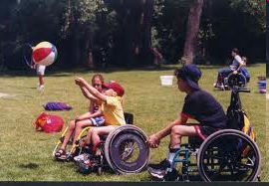
General Disability Etiquette
Realize that a person’s disability is just one small fact about them among a myriad of others. Do not assume you know anything about them just because of their disability.
Do not sensitize a disability by saying “afflicted with” or “victim of”. Instead, say Sheila is a person with multiple sclerosis.
Avoid using emotional or negative descriptors such as unfortunate, pitiful, deformed, wheelchair bound, and so on.

Slide 7
General Disability Etiquette
Always communicate directly with the person —not their spouse or attendant or interpreter! Always use eye contact at their eye level, whenever possible. Never refer to the person in third person when the individual is present.
Act naturally—don’t avoid communicating with them—treat the individual just like you would treat anyone else.
Most people with disabilities will ask for assistance when they need it. If it is obvious they need assistance and have not asked, then feel free to offer assistance but ask them how you can assist them.
When talking with a person who uses a wheelchair, never lean on or touch the wheelchair—this is a part of the personal space of the individual using the chair.
When in doubt, ask the person how you should interact with them in various situations.

Slide 8
“People First” Language
People First Language
Negative Language
She has a physical disability.
He has a learning disability.
She has a brain injury.
He has a mental illness.
She is crippled/ handicapped.
He is retarded.
She is brain damaged.
He is crazy.

Slide 9
Considerations for People who are Deaf or Hard of Hearing
Do not assume a person who is non-verbal is also cognitively limited—most understand everything you are saying.
To get the attention of a person who is deaf or hard of hearing, tap them on the shoulder, wave your hand, or flick the lights.
If an interpreter is not available for people who are deaf or hard of hearing, provide pen and paper and give them the opportunity to write down their needs. As soon as possible, locate an interpreter for their assistance.

Slide 10
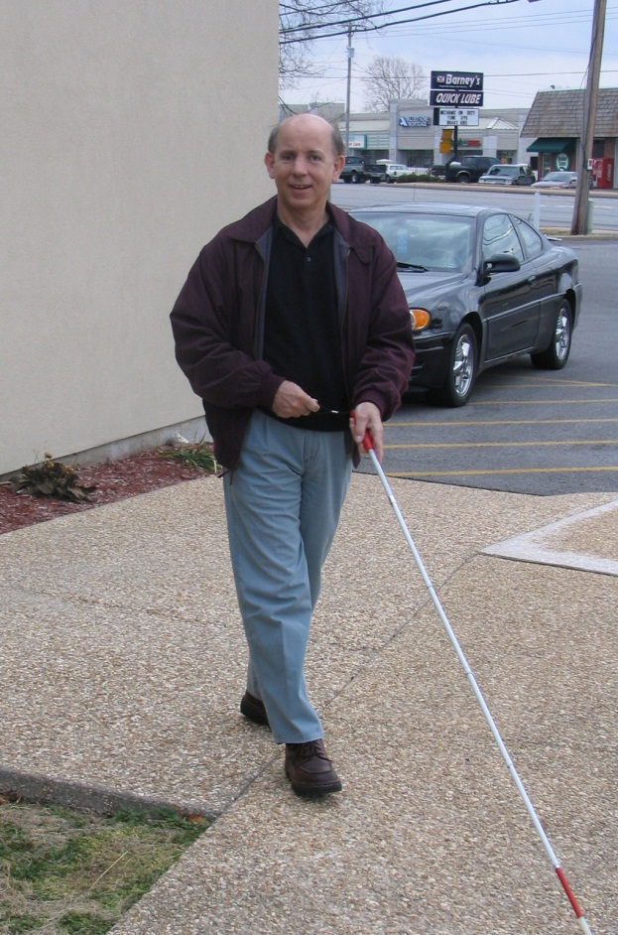
Common Considerations for People with Visual Impairments
Remember that service animals are NOT pets and you should not attempt to pet or play with the animal—they are working.
Assist a person with visual impairments when requested—allow the person to take your arm so that you guide the individual rather than leading them.
When greeting a person with severe vision loss, always identify yourself and others who may be with you. Also, remember to look at them when you are communicating with them.
Communicate any written information verbally.
Do not shout, speak at a normal volume to the person.

Slide 11
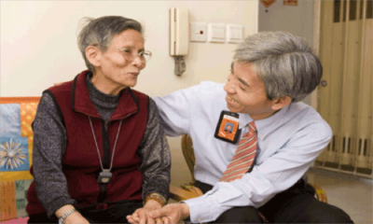
Emergency Considerations for Elderly
Be patient! Often, people with access and functional needs may respond more slowly to a crisis or may not fully understand the extent of an emergency because of confusion, hearing problems, or language barriers
People with health concerns or disabilities are often afraid that they will be placed in a nursing facility during an emergency. Try to reassure them that they will receive community-based medical assistance
If the person has dementia or seems disoriented, identify yourself, explain why you are assisting them, speak slowly, and maintain eye contact.

Slide 12
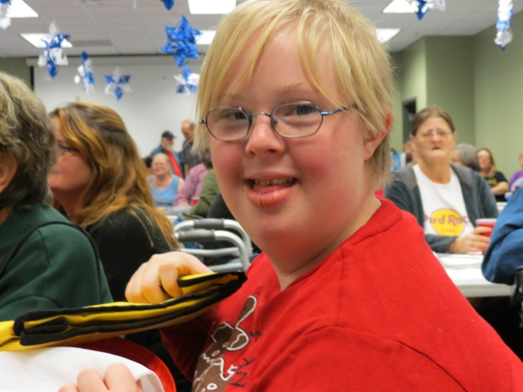
Emergency Considerations for People with Developmental Disabilities
Often, people on the autism spectrum display behaviors that mimic psychosis, defiance or belligerence. Give them space and the behaviors will typically reduce.
Many people with developmental disabilities or autism do not feel comfortable being touched. Respect their personal space as much as possible.
People with cognitive disabilities may need extra time to respond to questions. Phrase questions in simple to understand terms and speak clearly.
People with autism spectrum and/or seizure disorders often have difficulty with sirens and bright lights. Try talking with them in a quiet location that will make them feel safer.

Slide 13
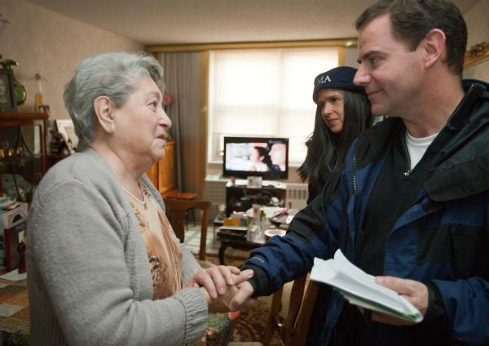
Considerations for People with Limited English Proficiency
Often, people with limited English proficiency do not understand weather alert systems or what severe storms like tornados can do
There may be fear of the government, especially if the person or family is undocumented
Confusion in translation
Often seek assistance from churches and extended family before “outsiders”

Slide 14
Resources for Individuals and Families
Ready.gov www.ready.gov
Red Cross Prepare www.redcross.org//prepare
Emergency 2.0 http://emergency20wiki.org/wiki/index.php/Main_Page
Do 1 Thing Family Preparation http://do1thing.com/
CDC Emergency Planning http://emergency.cdc.gov/preparedness/
The Independent Living Center www.ilcenter.org/emergencyservices.html

Slide 15
Resources for Businesses and First Responders
First Responder Toolkit: http://preparednessforall.files.wordpress.com/2012/06/afnfl.png
Interactive Mobile Tips for First Responders: http://disabilitytips.tamu.edu/
National Service Inclusion Project www.serviceandinclusion.org/index.php?page=emergency
FEMA www.fema.gov

Slide 16
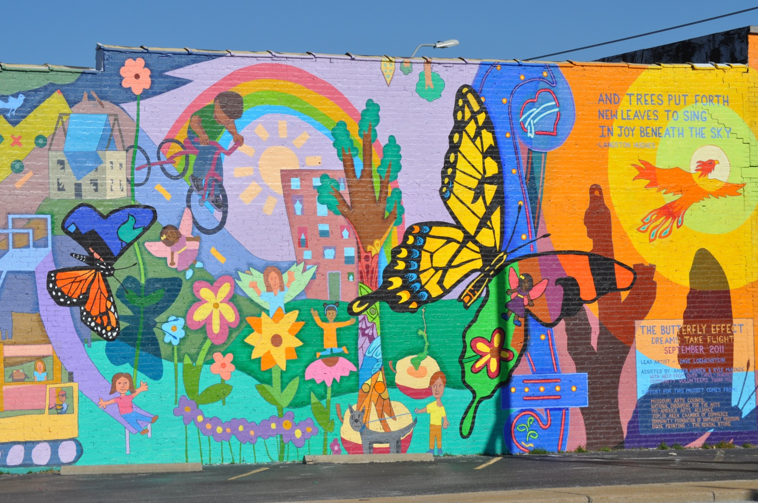
Stephanie Brady
Director of Programs
The Independent Living Center
2639 E. 34th Street
Joplin, MO 64804
800-346-8951
417-659-8086
www.ilcenter.org
sbrady@ilcenter.org

