Slide 1
Connecting the Pieces for Functional Needs
The Joplin, Missouri Tornado
Presented by Stephanie Brady, The Independent Living Center
sbrady@ilcenter.org

Slide 2
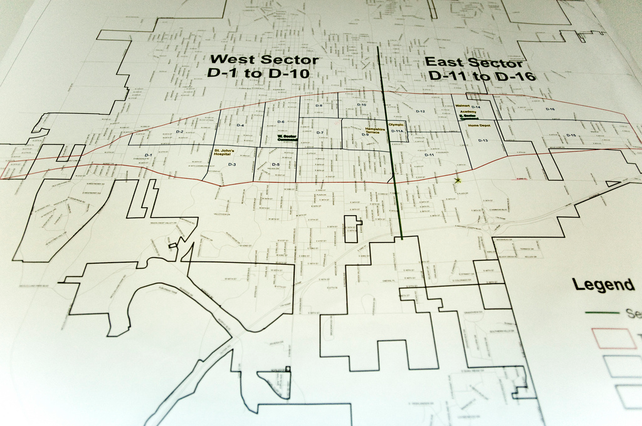

Slide 3
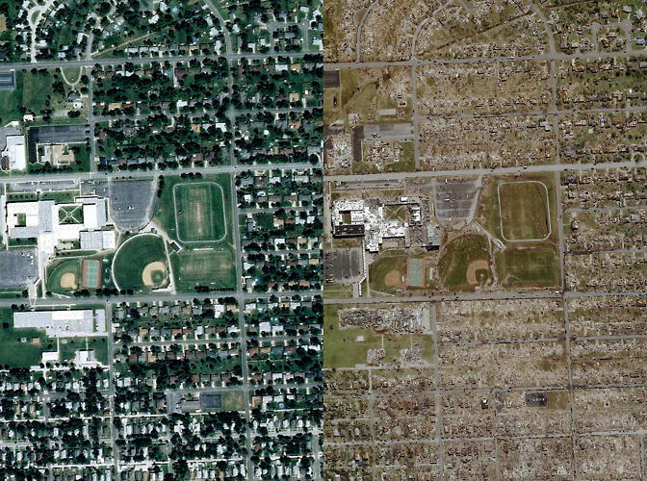

Slide 4
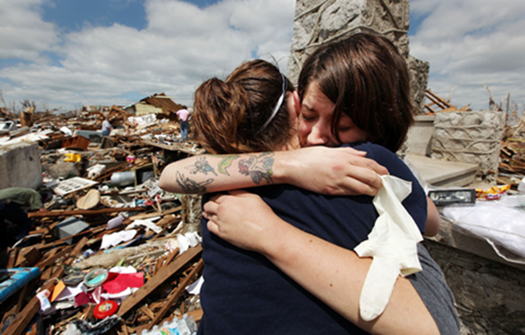
Joplin Tornado, the Numbers
162 lives lost, 7 were consumers of TILC
64 consumers homes were completely destroyed
Over 7000 homes and 800 businesses were completely destroyed
18 churches were destroyed
6 public schools and one private school were destroyed
Over 40% of the medical infrastructure was destroyed
3 nursing homes were destroyed
Today, 90.4% of destroyed properties either rebuilt or under permit
All 586 families that were in FEMA housing found permanent housing
As a community, we are more accessible than ever before!

Slide 5
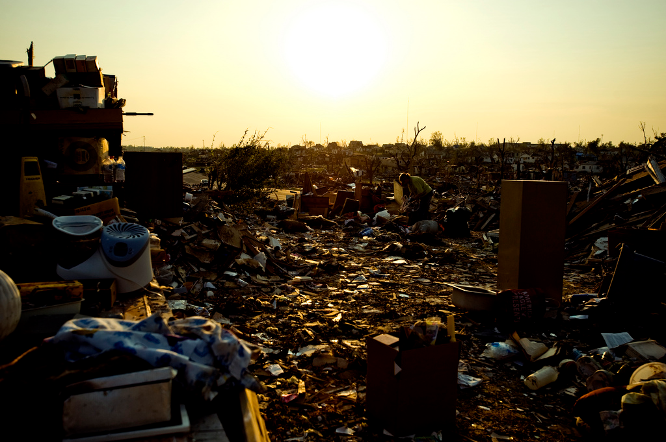

Slide 6
Overview: The Joplin Tornado
Item 1
Whole Community Approach and Pre-Disaster Planning
Item 2
Response Phase
Item 3
Initial Recovery Phase
Item 4
Long-Term Recovery Phase
Item 5
What Worked Well, What Didn’t
Item 6
Discussion and Questions

Slide 7
What is Whole Community?
According to FEMA: “an approach to emergency management that reinforces the fact that FEMA is only one part of our nation’s emergency management team . . . and that collectively we must meet the needs of the entire community in each of these areas.”
Essentially, the whole community is planning for and with EVERYONE, regardless of access or functional need and with EVERYONE at the table-- all agencies, community organizations, and consumers working together

Slide 8
St. Mary’s Catholic Church and Elementary School and Green Brier Nursing Home

Slide 9
Who are people with access and functional needs?
Typically anyone who may have difficulty accessing emergency services in a disaster, including:
People with physical disabilities
People with mental health disabilities
People with developmental or cognitive disabilities
People with sensory impairments (vision, hearing)
People with chronic health problems
Senior citizens
Children
People with limited English Proficiency
Geographically or culturally isolated

Slide 10
Pre-Disaster Planning
COAD Participation (Community Organizations Active in Disaster)
Jasper/Newton County Healthcare Coalition—Emergency Response Team (MOU)
CERT Training (Community Emergency Response Teams)
Red Cross Volunteer Training
Center and Community Emergency Plans
Consumer Comprehensive Emergency/Disaster Plans
Disability/Senior Resource Council
NCIL/FEMA MOU for CILs to work directly with FEMA
Healthcare Data at 911 Centers for PWD/elderly

Slide 11
What could have been better pre-disaster?
Back-up power for healthcare agencies needs to be more substantial
Need for analog telephone lines for all healthcare agencies
Back-up water supply
More accessible storm shelters
More education about and options for alert systems that meet the needs of people with disabilities or from non-English speaking cultures
Home-owner or renter insurance (including home inventories)
Nursing facility disaster preparation

Slide 12
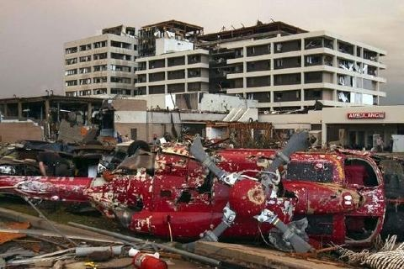

Slide 13
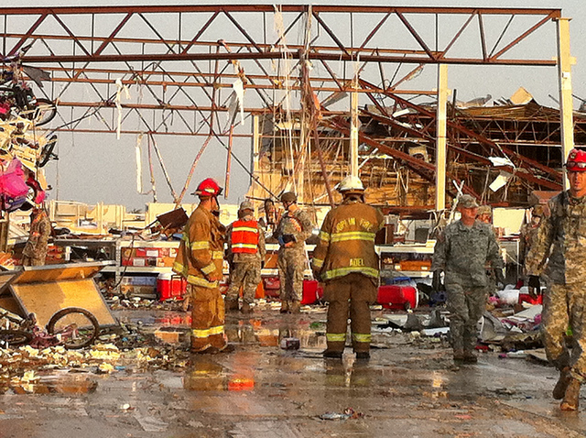
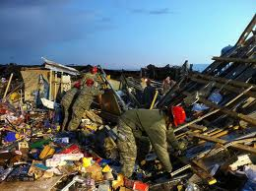
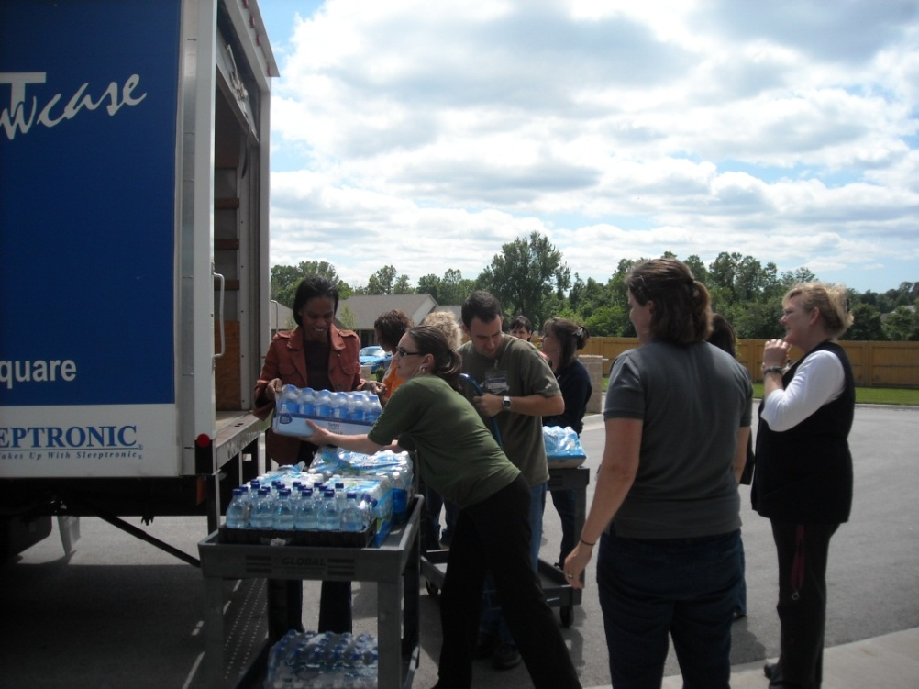
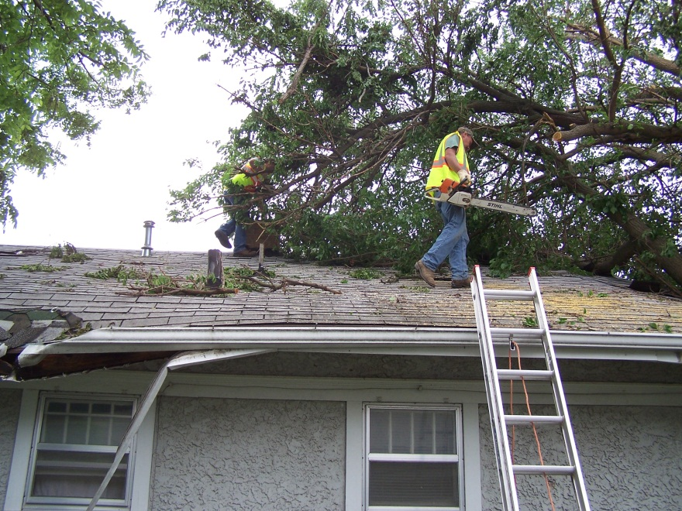
Response Phase

Slide 14
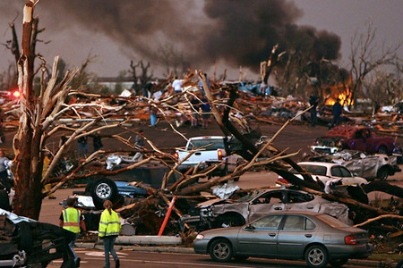

Slide 15
What went well in Response
FACEBOOK and Bright Futures/Rebuild Joplin Website!!!
TILC had nearly immediate contact with Gay Jones, FEMA Disability Integration Specialist with the Office of Disability Integration and Coordination www.fema.gov/about/odic/
Disability/Senior Disaster Resource Group Weekly Meetings
Joplin Public Schools Used School Buses to Transport People
TILC Sister Organizations assistance with search and rescue, debris removal, location of consumers, delivering replacement equipment, etc.
TILC made contact with the American Red Cross within three hours of the disaster to transport people with disabilities and to deliver DME to shelters
TILC staff and other disability groups set up resources at the shelter and the Multi-Agency Resource Center to provide intake and information

Slide 16
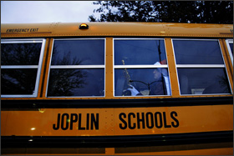
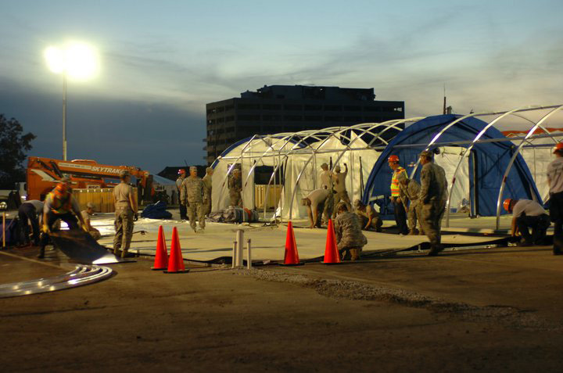
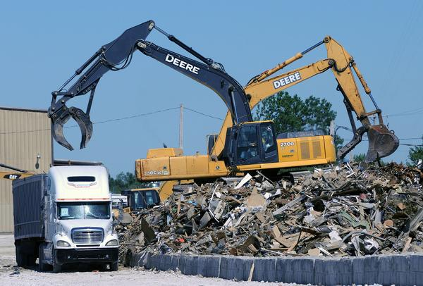

Slide 17
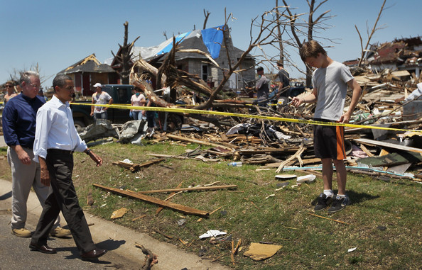
What went well in Response
MSSU Shelter and Health Services Center
Database: TILC had lists of all consumers in various formats with emergency contacts, emergency needs, etc.
National, Community and Regional Emergency Response including Faith-Based Organizations, Volunteers, social service
Street Cleaning/Debris Removal
Cross-Agency Communication

Slide 18
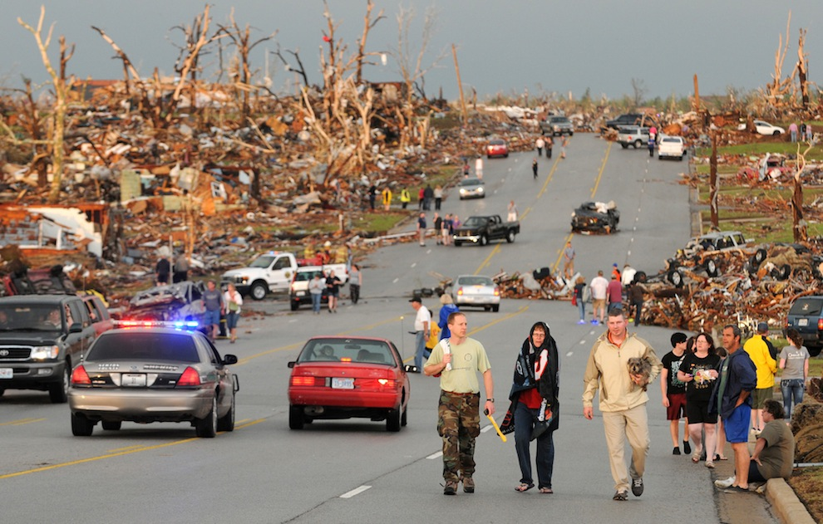

Slide 19
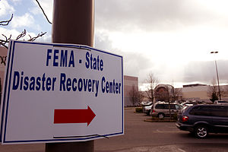
What Could be Improved in Response?
Signage at the Red Cross Shelter and the Disaster Recovery Center (FEMA/SEMA) was originally difficult to see, often not accessible
Access to Disaster Recovery Center
FEMA Outreach to “at-risk” populations
Communication about services and resources--Misinformation
Triage Confusion between AmeriCorps and FEMA
Confusion at Hospitals and the Morgue (Will Norton)
Communicating to the public what is needed—donation remorse!

Slide 20
What went well in Early Recovery
FEMA worked with various community and city groups to develop task forces to facilitate recovery. (Housing Task Force, School and Facilities Task Force, etc.) Crucial for disability organizations to participate in each task force!
TILC worked with the Housing Task force and the Senior/Disability Group to develop a housing intake sheet to determine emergency housing needs as well as priorities for the FEMA Temporary Housing Units
Coordinating with FEMA to offer alternative options for registering for assistance (mobile DRC, etc.)
Trained FEMA Community Relations staff in disability awareness
Community and Faith-Based Partnerships
MFH Funding for replacement DME and portable ramps, MCB Funding to assist the people who are blind
FEMA Temporary Housing Unit accessibility

Slide 21
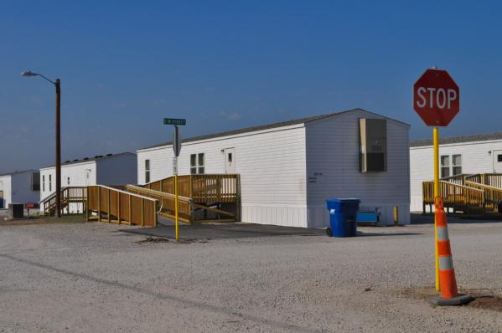

Slide 22
Improvements for Early Recovery
FEMA Coordination of Sign Language Interpreters
Options for FEMA Registration
Fear of the Process
Confusion
People who are deaf told to register using TTY
Cognitive Disabilities
ESL Populations
Need to continue to educate participants and agencies about the needs/rights of people with disabilities
Access to medical records and medications
Transportation needs for people with disabilities

Slide 23
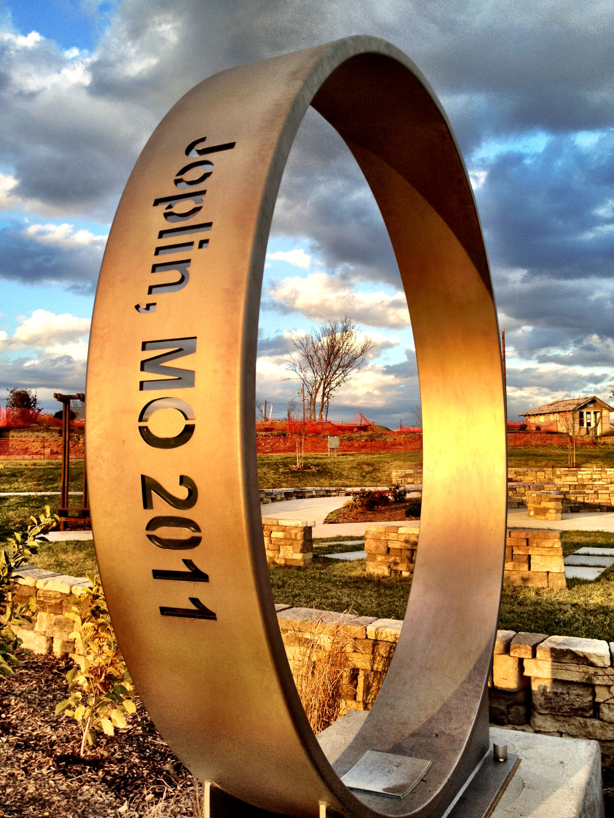

Slide 24
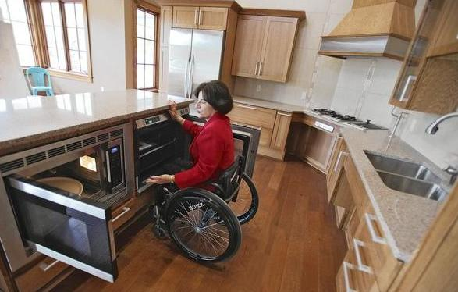
What is going well in Long Term Recovery
Relationships with disaster organizations & community agencies
Continued Volunteers
Citizen’s Advisory Recovery Team—focus on accessibility for entire community rebuild
KU School of Architecture Partnership for UD House Plans
Extended Community Transportation Options
Long Term Recovery Committee and Disaster Case Management Resources
Missouri Housing Development Commission Housing and Universal Design

Slide 25
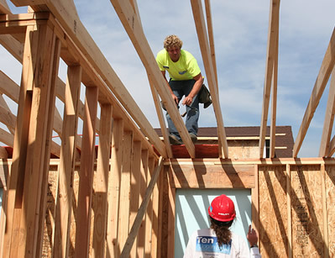

Slide 26
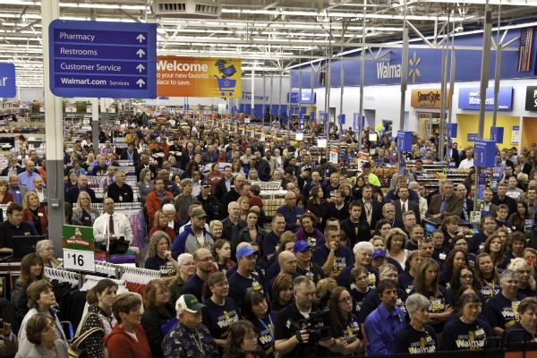

Slide 27
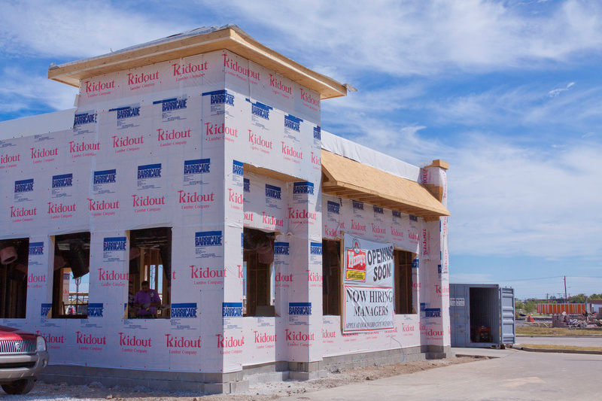

Slide 28
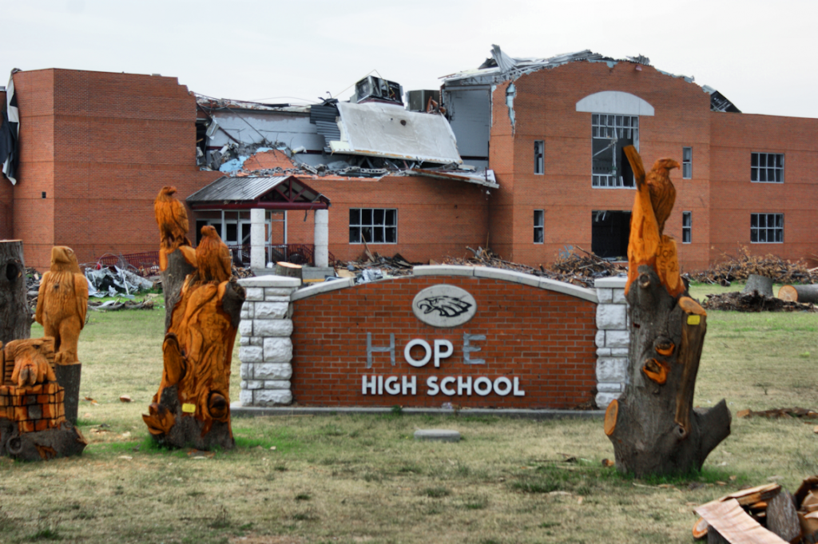
Temporary Schools
Temporary school facilities opened on August 17 – temporary facilities are equipped with tornado shelters and built to ensure that the shelters are easily accessible
Every school opened on time as promised by the school administration (6 public schools)
Every student with a disability in public schools started on time—according to FEMA, this is the first time after a major disaster that this has happened

Slide 29
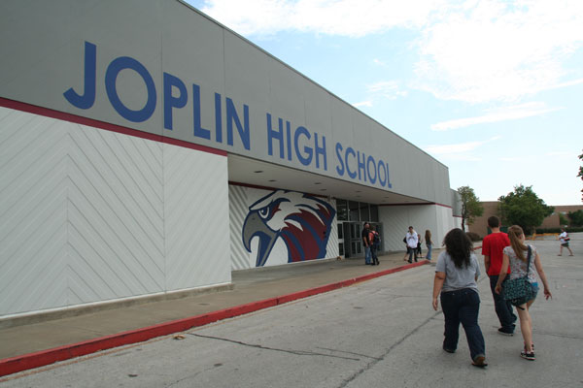
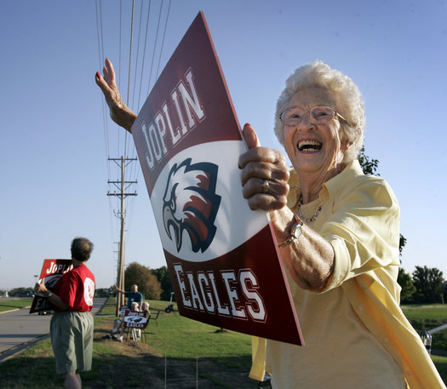

Slide 30
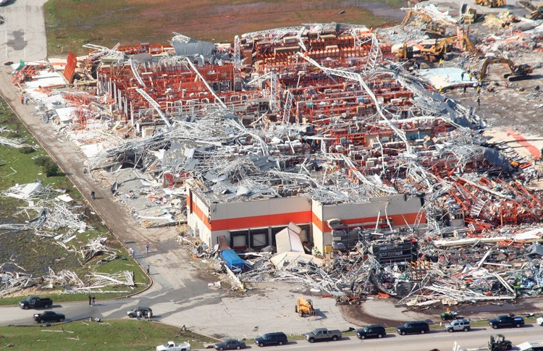
Improvements for Long Term Recovery
Contractor Fraud/Issues and Insurance Issues
Redeveloping Alert Systems
Communication between all parties is difficult (FEMA, SEMA, City, County, COAD, LTRC, CERT, Emergency Entities, etc.)
Making sure people with disabilities are at the table at every stage of the decision-making
Changing legislation to make large companies and nursing facilities have safe rooms (Home Depot sets the bar)

Slide 31
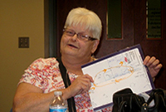
TILC’s Emergency Services Program— Funded by the CDC Foundation
Emergency Plan Development
Red Cross Go Kits
Vial of Life
Community Education
Elementary School Education
Adaptive Alerting Devices
Online Resources

Slide 32
Resources for Emergency Preparedness for People with Access and Functional Needs
Ready.gov www.ready.gov
Red Cross Prepare www.redcross.org//prepare
Emergency 2.0 http://emergency20wiki.org/wiki/index.php/Main_Page
National Service Inclusion Project www.serviceandinclusion.org/index.php?page=emergency
Do 1 Thing Family Preparation http://do1thing.com/
CDC Emergency Planning http://emergency.cdc.gov/preparedness/
The Independent Living Center www.ilcenter.org/emergencyservices.html
Interactive Mobile Tips for First Responders: http://disabilitytips.tamu.edu/
FEMA www.fema.gov

Slide 33
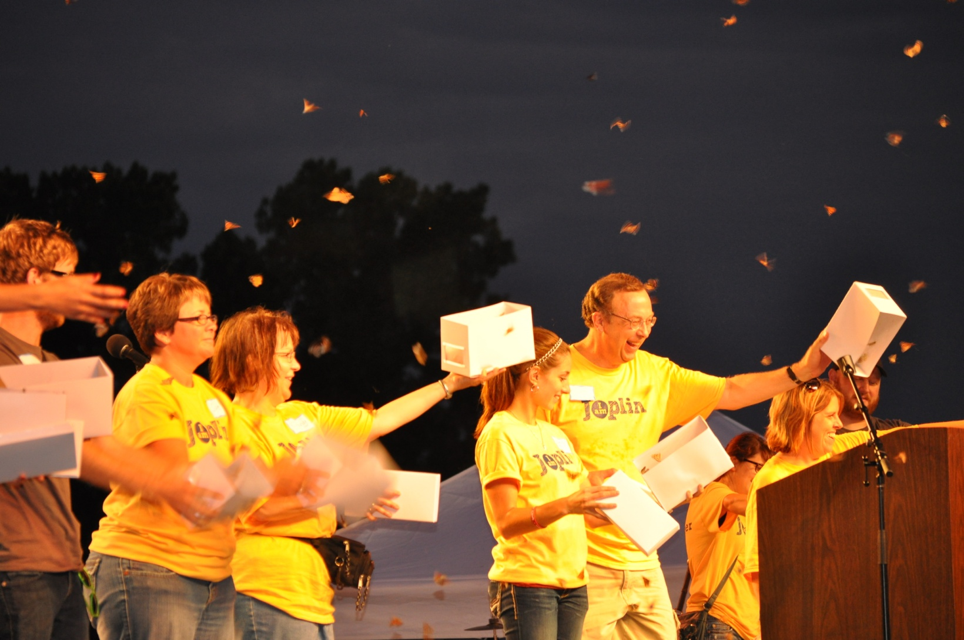
Picture Page Layout
Each family who lost a child was given their own butterfly to release at the I Am Joplin event, along with 2,000 butterfly’s to remember and honor the 14 children and one staff member who lost their lives on May 22.

Slide 34
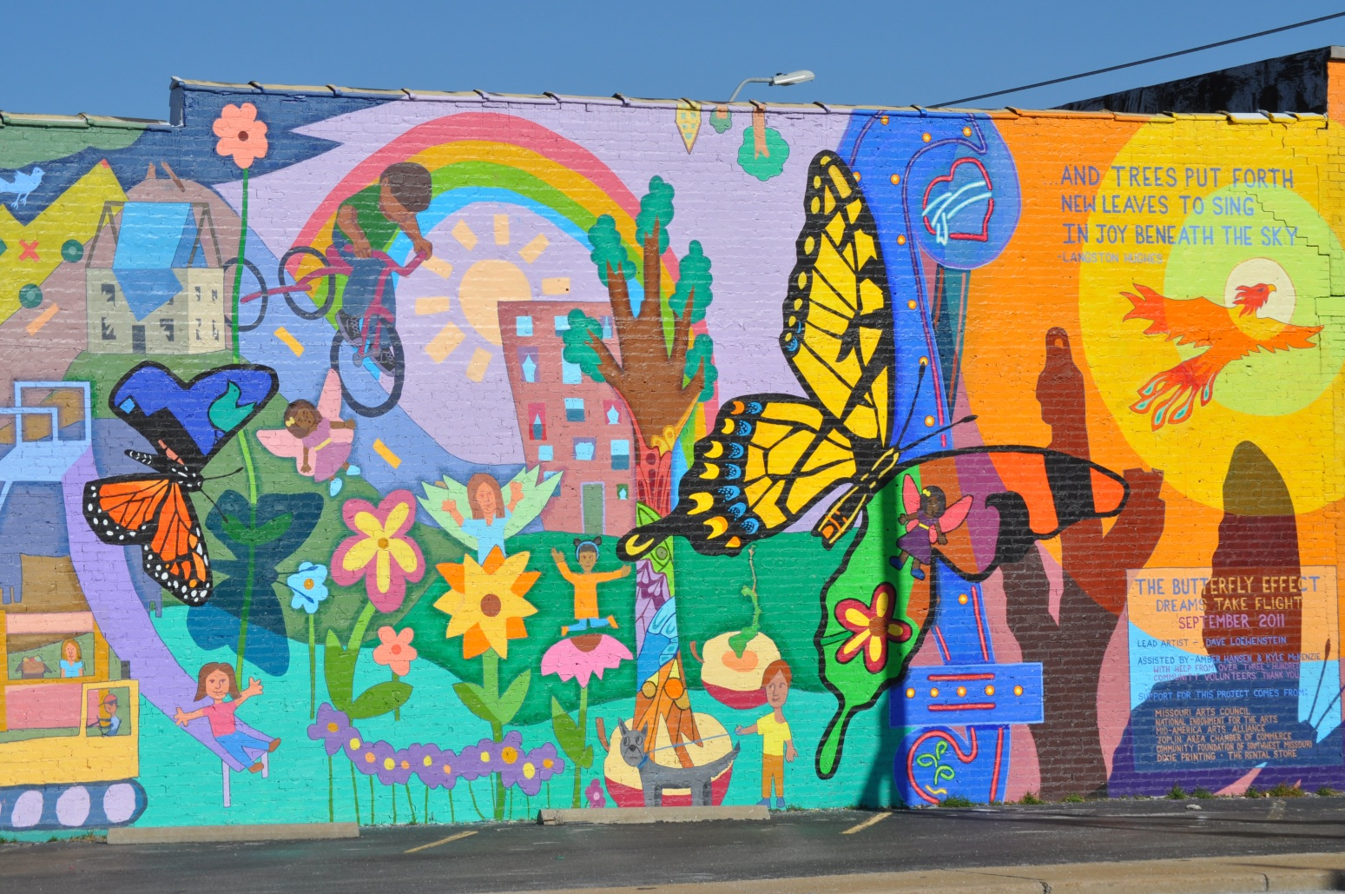
Stephanie Brady
Director of Programs
The Independent Living Center
2639 E. 34th Street
Joplin, MO 64804
800-346-8951
sbrady@ilcenter.org

