Slide 1
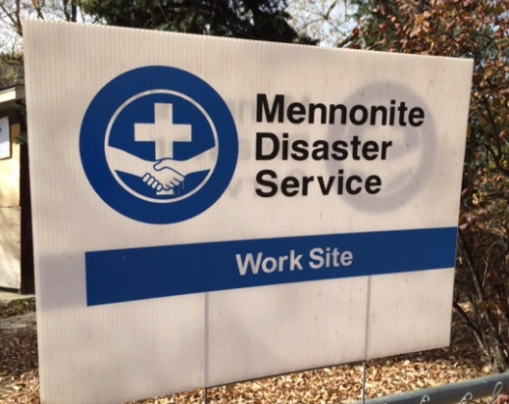
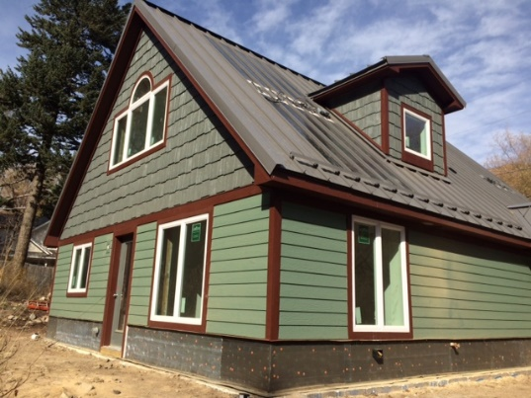
Volunteer Coordinator Updates
Two properties in the Rose M. subdivision have been purchased for Nancy and Karen by Catholic Charities through Mennonite Disaster Services to rebuild homes
Both residents are in the design process and Nancy is moving toward permitting
MDS will return to town mid-January through March to build these two homes and to participate on Matt & Julie's rebuild and Mark & Adrienne's repair project
Volunteers will again live in the Loupee residences and Craigo/Swartz residence
Current Builds:
Carolyn's damaged roof was removed today. The metal replacements are being shipped and will be repaired asap. This will not affect her moving in. The final inspection is set for next week!
Kohlhaas/Constantine permit is approved and Habitat will move forward with foundation work!

